Slide 1

CSE 406: Computer Security Sessional
OSSEC
1805009 - MD Zaraees Uddin Shah
1805021 - Abdus Samee

Slide 2
Overview
Open Source Host-based IDS (HIDS)
Main tasks:
Log Analysis
File Integrity Checking
Host-based anomaly detection (for UNIX: rootkit detection)
Active response
Real-time alerting
Supported OS:
Linux
OpenBSD
FreeBSD
Mac OS X
Windows

Slide 3
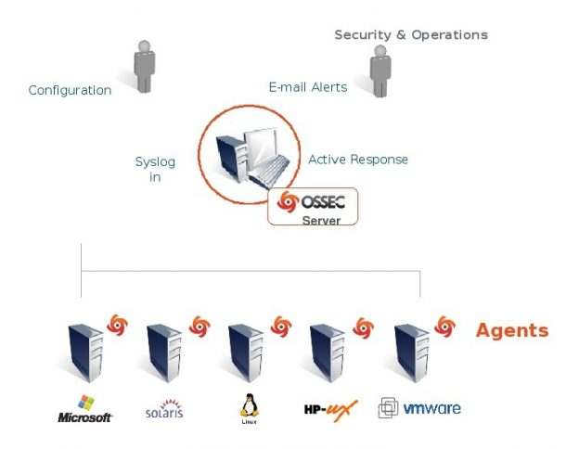
OSSEC Architecture
Server: Ubuntu 20.04 LTS Azure Cloud (seed)
Agent 1: Ubuntu 20.04 LTS Azure Cloud
Attacker: Kali Linux Azure Cloud

Slide 4
Log monitoring/analysis

Slide 5
Setup
Let’s simulate
Log monitoring is done on the server in real-time
Simulation:
The Kali VM hosts a malicious payload on its server
The agent downloads it, simulating a malicious website
That payload is executed in the agent terminal
Meanwhile, the Kali VM opens up an nc connection. It gets access of agent when payload is executed
The VM then creates a user and logs into the agent

Slide 6
Rootkit Detection

Slide 7
Setup
Let’s simulate
Rootkit detection is observed on the OSSEC Server.
Simulation
First we will download a malicious payload in OSSEC agent
Running the script in the payload will change the os commands
We can verify it by running ‘ls’ (output: ls not found)
In the OSSEC Server rootkit anomaly will be detected after some time (5 minutes)

Slide 8
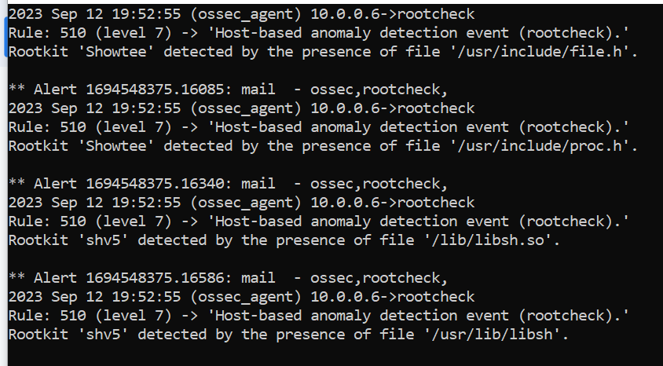

Slide 9
Thank You…

